Slide 1
INFERNAL BATTLE AN AI-BASED ARCADE FIGHTING GAME USING UNREAL ENGINE AND C++
ANUBHAV SHARMA 2K18/IT/029
ARJUN CHOUDHRY 2K18/IT/031

Slide 2

ABSTRACT
AI algorithms used in games, or “game AI”, refers to an extremely broad set of computer algorithms ranging from robotics, computer graphics, control theory (both by the user and the computer) and computer science in general. However, contrary to popular belief, game AI is often not made up of "true AI", i.e., the techniques used do not necessarily help the computer “learn” or other standard criteria, but only constitutes "automated computation" or a predetermined and limited set of responses to a predetermined and limited set of inputs.

Slide 3
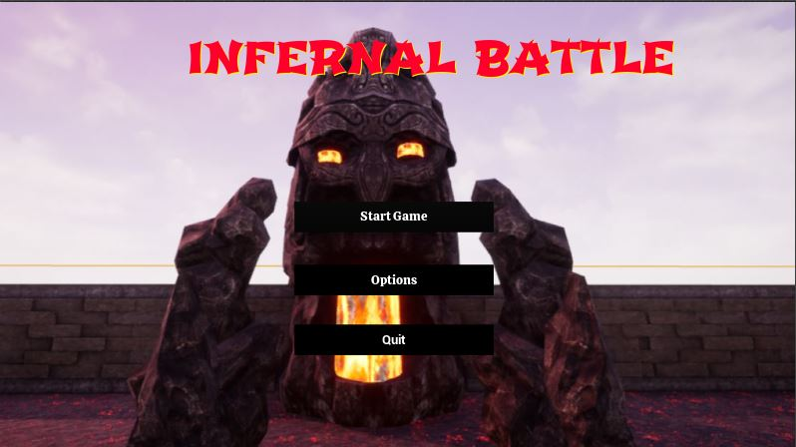
INTRODUCTION
In this project, we have created a single player, AI-based, Arcade fighting game called Infernal Battle. This is a human versus computer game in which our character, Bryan, is tasked with fighting a demon, Skin Hunter. The latter is controlled by the computer, hence is an NPC.
The game has been built using Unreal Engine 4.25.4, built using a C++ backend. The main workflow has been created using visual scripting, with the code further optimised and cross-checked by editing the code. Our project uses around 70 classes for function calls which are either pre-defined or custom designed.

Slide 4
PRIOR KNOWLEDGE REQUIRED
Workflow Designing using Visual Scripting
Knowledge of C++, Blueprinting and Classes
Unreal Engine: We chose Unreal Engine over Unity due to its significant use of visual scripting and the use of a C++ backend. The major challenges in developing a game using Unreal Engine are developing the controls of the player and the computer-controlled character.
AI Search Algorithms: Prior knowledge of AI search algorithms was very important for proper control of the computer-controlled character. We chose a modified A* algorithm for the same.

Slide 5
STATE SPACE SEARCH
Agent: Our agent is a problem-solving goal-based agent which searches for the protagonist character of the game (Bryan) using AI Search-based techniques, and tries to reduce Bryan’s health to zero after finding him.
States: All the positions in the arena for battle in the game “Infernal battle” are states in our project.
Initial State: The initial state of the agent is situated near the centre of the arena.
Goal State: The goal state keeps changing according to the inputs given by the user to change the position of Bryan in the game.

Slide 6
STATE SPACE SEARCH
Action: The agent can move left, right, in front, backward, and diagonally as well from its current position. The agent can punch to hit the target to reduce its health and achieve the objective of the game.
Transition Model: The change in position and the fighting pattern of the agent with respect to the player’s position constitute the transition model in our project.
Goal Test: When the agent detects the player, that state of the agent is the goal state for that instant of time till the player moves again and the goal state changes again.
Path Cost: The cost of movement is delay, as a movement of the agent in the wrong direction would give the player time to attack the agent and ultimately win the game. Even an attack movement results in some delay as the agent cannot move while it is attacking.

Slide 7
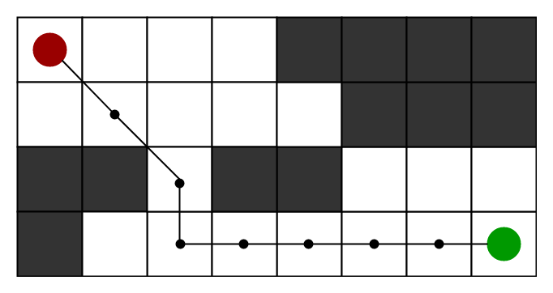
A* SEARCH ALGORITHM
In our game, we have used A* algorithm code with a slight modification. In Unreal Engine program, each node is a grid in the arena and as we are constantly changing the destination node, the agent needs to revise the destination node.
In our game, the agent continuously searches for the player to quickly kill him. For this quick path-finding, A* search algorithm served the purpose best. Other search algorithm would not have been as time efficient to be able to constantly change the destination in real time. However, using A* algorithm, by keeping our heuristics for the player node updated each time it moves, the agent is able to quickly find and attack the agent.

Slide 8
A* SEARCH ALGORITHM
The algorithm for A* implementation is as follows:
Add the start point to Open. Loop until a path has been found to the endpoint or all the tiles have been exhausted (e.g. no path can be found)
Find the tile with the lowest FCost in Open (Tile X)
Remove Tile X from Open; Add Tile X to Closed
Set the parent index to the index of the tile in Closed
Get the neighbours of Tile X and do the following steps for all the neighbours (Neighbour Y)
Check that neighbour Y is a tile which we can walk on and that it is not in Closed
Calculate the GCost, HCost, and FCost for NeighBour Y
If neighbour Y is in the Open array if so update the FCost is lower with the new costs and the parent index. If the neighbour is not in the array add it to Open.
When all neighbours have been checked go continue with the initial loop of the Open array

Slide 9
IMPLEMENTATION DETAILS
Programming Languages Used | C++ (direct and via Blueprinting)
Operating System | Created in Windows, but packageable for Windows, Linux, MacOS, Android
Library, Packages or APIs Used | Unreal Engine Modules and Libraries, Standard C++ classes
Interface Design (GUI) | Classes with parent class Unreal Engine Viewport Widget

Slide 10
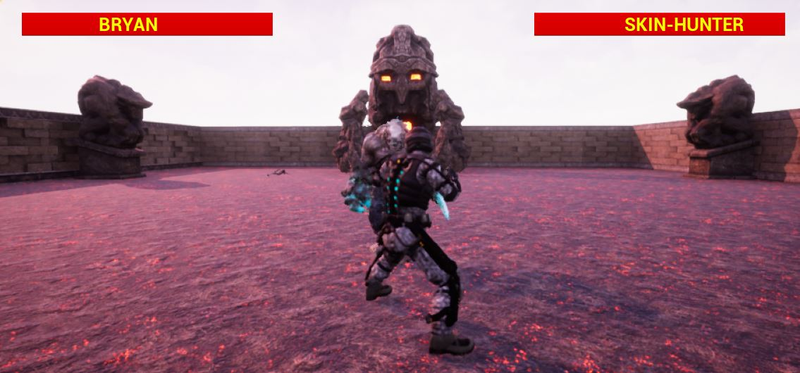
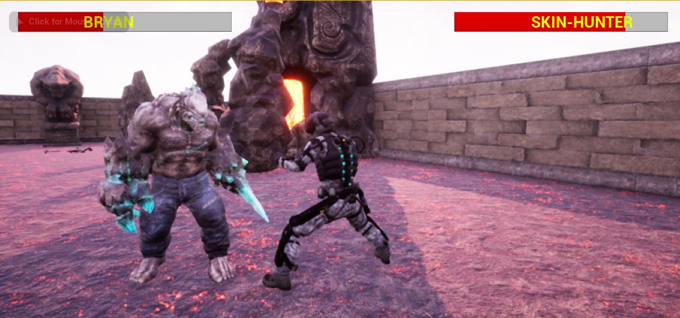
GAME UI
In Combat
In video games, developers use graphics and text to display relevant information to the player such as health or score. This is known as the user interface (UI). We have created a UI in Unreal Engine 4 using Unreal Motion Graphics (UMG).
This is explained in three steps:
Character Setup
Game Setting
Game Environment

Slide 11
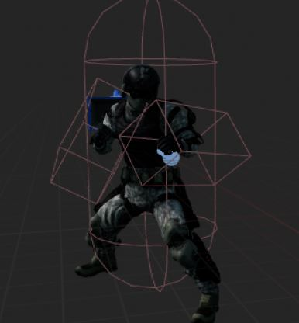
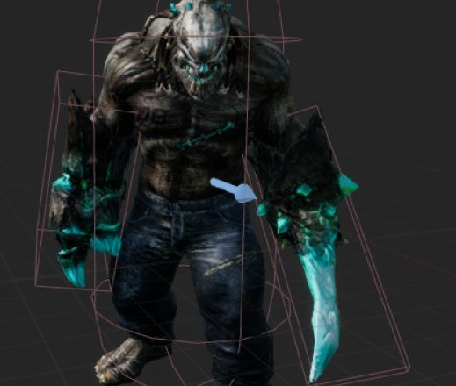
CHARACTER SETUP:
Primary workflow for character setup in UE4 :
Creating an art assets (Skeletal Meshes) and animations, using a 3rd party digital content creation (DCC) package such as 3ds Max or Maya.
Importing of Skeletal Meshes and animations into UE4 by creating a new Skeleton asset for new Skeletal Meshes.
Create a Player Controller Blueprint- handles inputs from the player.
Create a Blueprint for a Character or Pawn to parse inputs and control the actual movement (not skeletal animation) of the character.
Constructing the Animation Blueprint for the character.
Creating a Blueprint that utilizes the custom Player Controller and any other custom script assets.

Slide 12
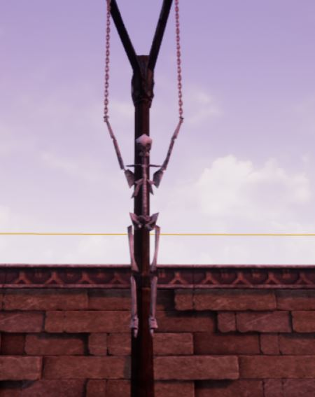
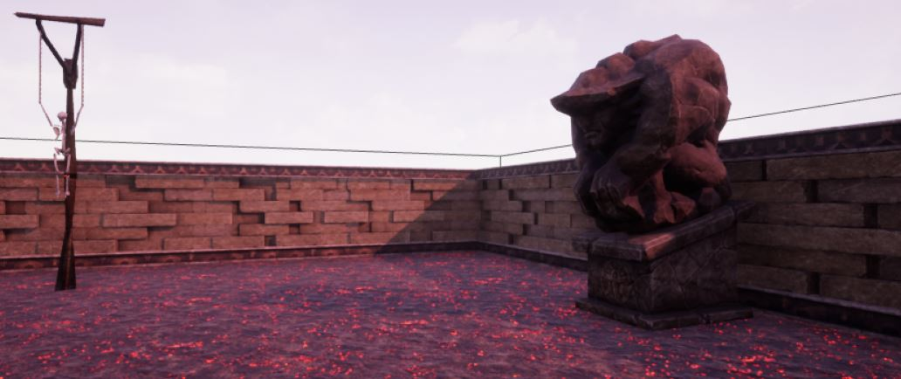
GAME SETTINGS: BLOCKOUTS
Blockout Tools is a lightweight and extremely easy to use set of tools to quickly block out (greybox) the levels in Unreal Engine 4. It consists of various primitive elements with convenient scale and transform controls and custom tri-planar grid material to ease the level design workflow.

Slide 13
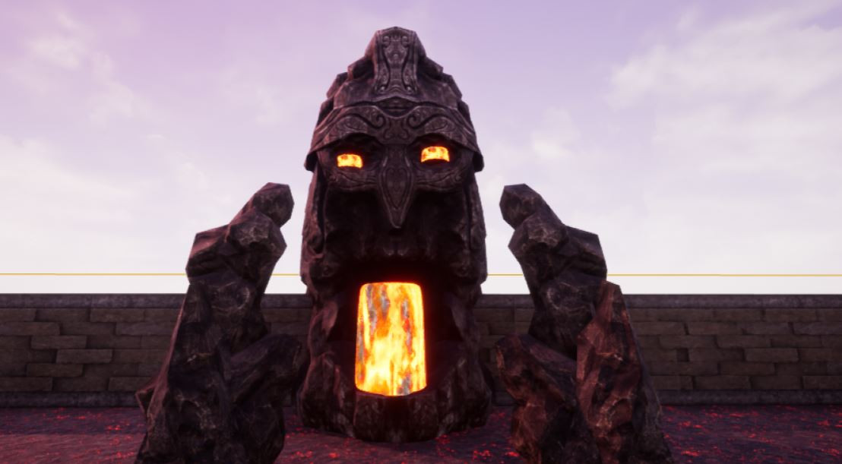
Game Environment-
This is a short walking playable experience allowing the player to become fully immersed in a beautiful and eerie medieval environment. It highlights some of the most exciting new features in Unreal Engine 4.25.4. The environment is fully dynamic and utilizes the new Sky Atmosphere system to light the scene.
It includes:
Static Meshes
Textures
Floor component
NavMesh Bounds Volumes

Slide 14
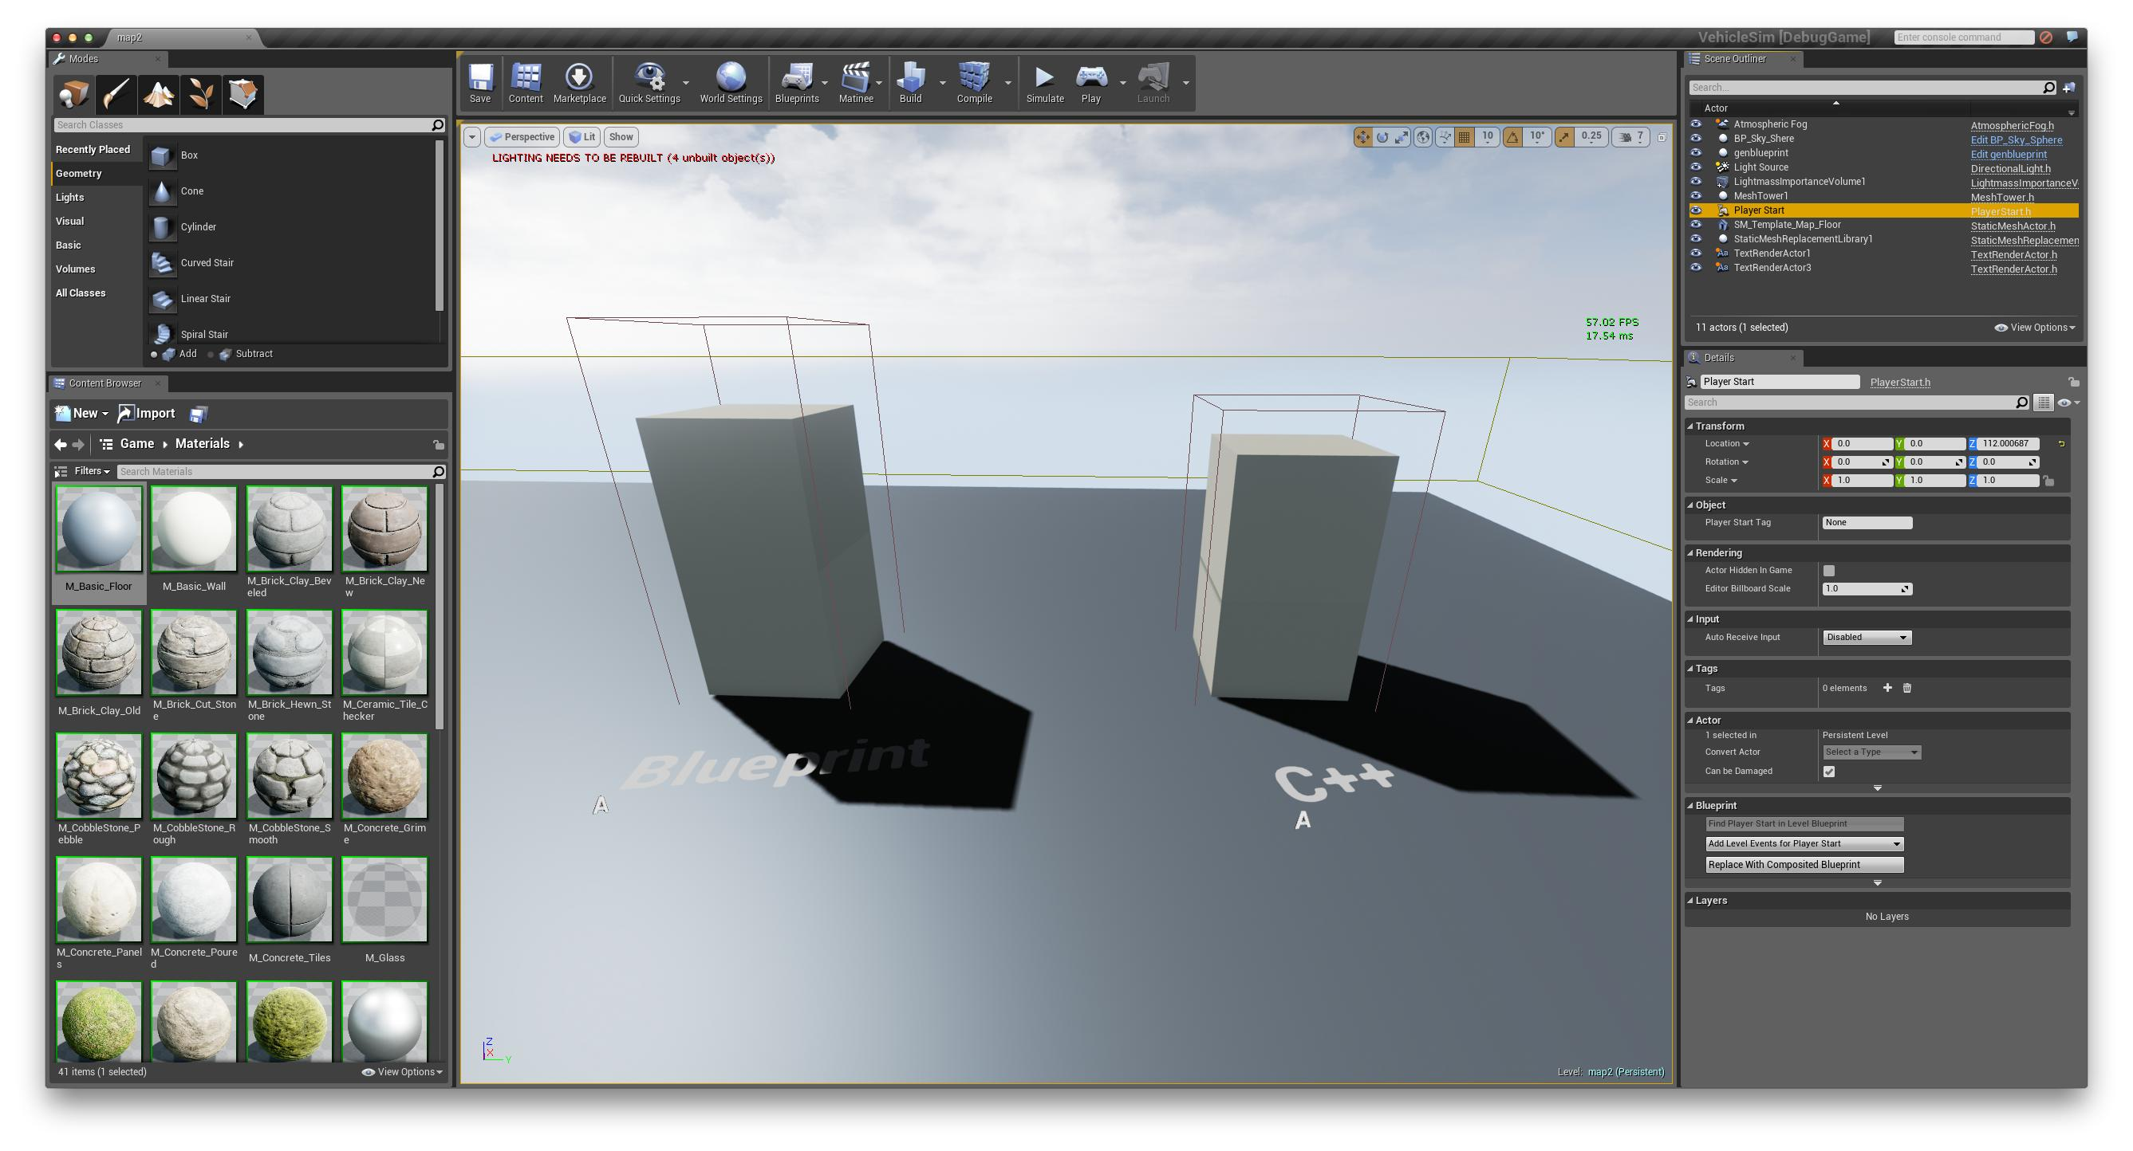
Static Meshes

Slide 15
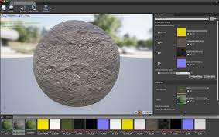
TEXTURES

Slide 16
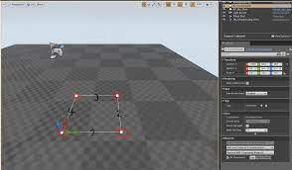
FLOOR COMPONENT:

Slide 17
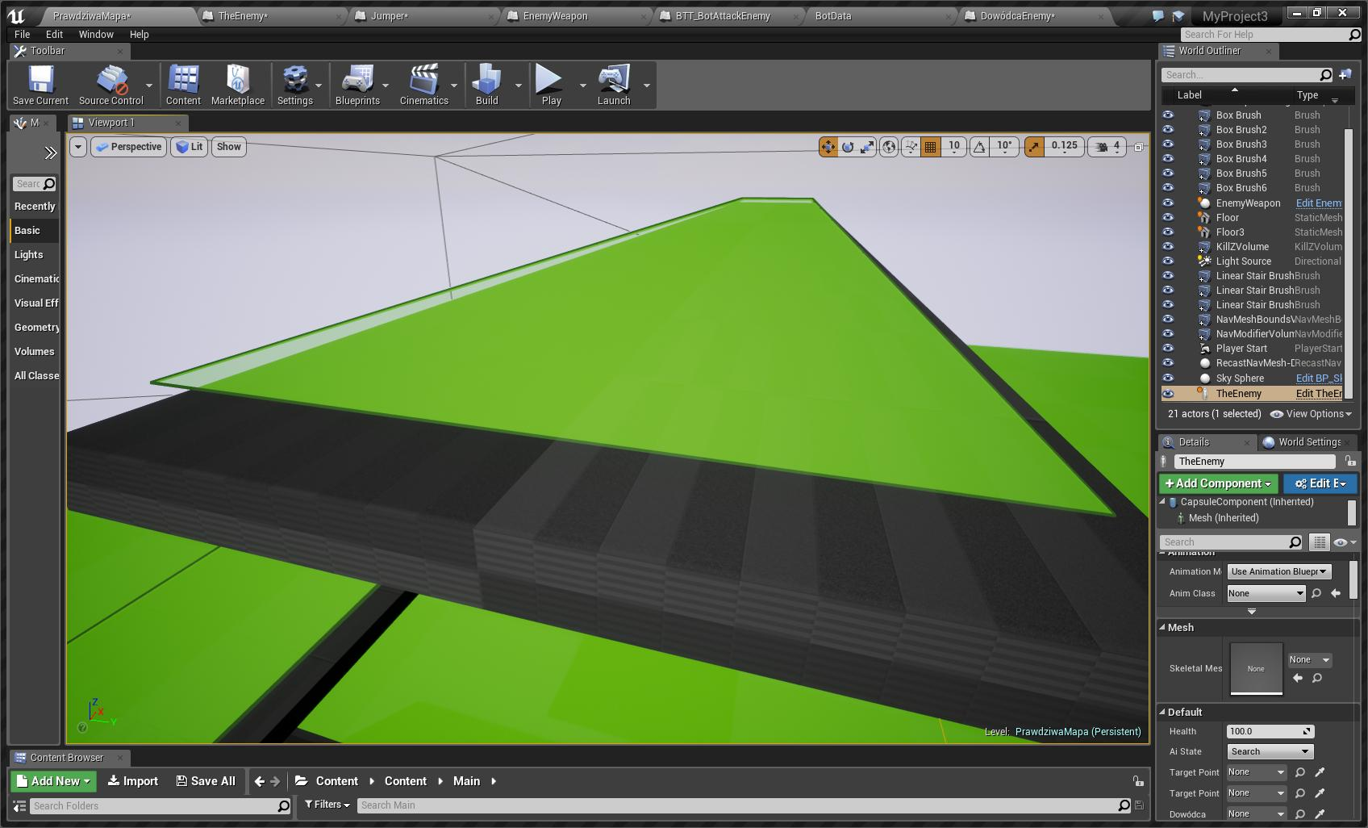
NavMesh Bounds Volume
NavMesh bound volume blocks the path builder that has no gameplay collision. It is a grid of triangles which are placed (automatically, in UE4) in the 3D environment. The area within the triangle is walkable and we have 3 edges that we can move to from each part.

Slide 18
COLLISION DETECTION MECHANISM
We have devised an intricate mechanism for detecting whether the player (Bryan) or the agent (skin hunter) have been hit by the other player in the game. For detecting this, we have put invisible box collision elements at both left and right arms of the players while constructing the character blueprint classes.
The invisible boundaries keep a check so that nothing violates it. This is managed by the function begin_overlap(), which checks the same. Whenever the invisible boundaries of the players get violated, a bool check variable called is_punching is checked to verify if the other player was punching at that time. If that was indeed the case, then the health bar (initiated with 100 health points) gets deducted by a value of 10 health points each time a hit is encountered.

Slide 19
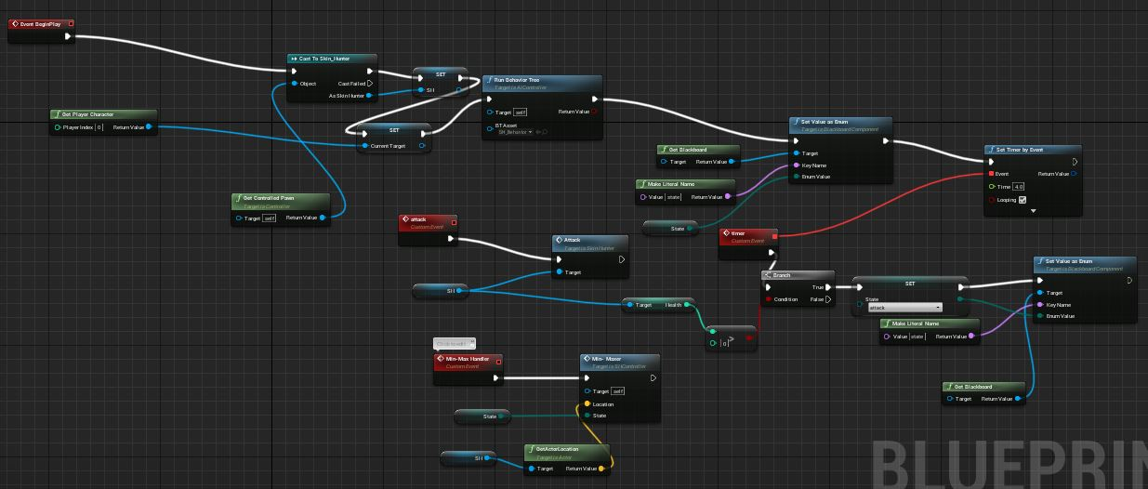
IN-GAME AI LOGIC

Slide 20
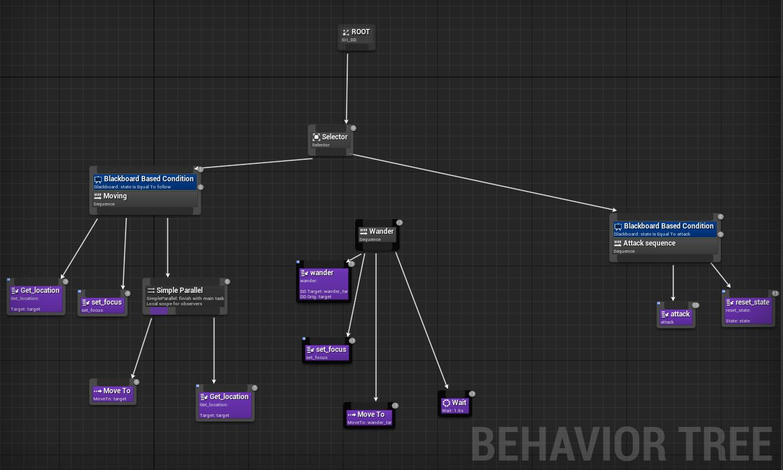
BEHAVIOUR TREE

Slide 21
FUTURE WORK
We intend to take this project further, and some of the features in our roadmap include:
Adding multiple playable characters to the game.
Adding newer and trickier levels/maps to the game.
Refining AI of the game to incorporate 2-3 NPCs at the same time.
Add a Special Move feature to the game to make it more exciting.
Increase the number of players and make it playable over the internet.
Add more movement modes like flying and swimming.
Giving each character a weapon for more damage.
Improve the in-game graphics.

Slide 22
REFERENCES
https://docs.unrealengine.com/en-US/AnimatingObjects/index.html
https://docs.unrealengine.com/en-US/Basics/Actors/index.html
https://www.oreilly.com/library/view/unreal-engine-4/9781784393120/ch04s03.html
https://www.nielsvandermolen.com/how-to-implement-custom-pathfinding-a-cc-in-unreal-engine-4/
https://medium.com/@mscansian/a-with-navigation-meshes-246fd9e72424
https://www.nielsvandermolen.com/how-to-implement-custom-pathfinding-a-cc-in-unreal-engine-4/

